Slide 1

Lecture 4
Software Design and Architecture
Rana Taimur Khan
Lecturer GCUF

Slide 2
Software Design Strategies Structured and Object-Oriented Design
When we are talking about software design strategies then there are two designs.
Structured Design
Object-Oriented Design

Slide 3
Software Design Strategies Structured and Object-Oriented Design
Structured Design:
System is design from a functional view point.
Conceived as a set of functions that are used to solve the problem at hand.
The system state is centralized and is shared among the functions operating on that state.

Slide 4
Software Design Strategies Structured and Object-Oriented Design
Structured Design:
What the set of functions/programs should be?
What each function should accomplish?
How functions should be organized in a hierarchy?
Start with the high-level view and progressively refine this into more detailed design.

Slide 5
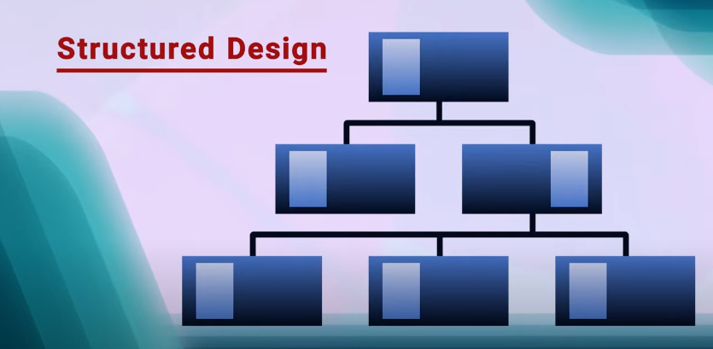
Software Design Strategies Structured and Object-Oriented Design

Slide 6
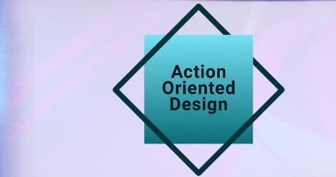

Slide 7
Software Design Strategies Structured and Object-Oriented Design
Object-Oriented Design:
Based on the idea of information hiding.
System is viewed as a collection of objects.
The system intelligence and state is decentralized, and each object manages its own state information.
Attributes (state)
Operation (Intelligence)
Objects communicate by exchanging messages.

Slide 8
Software Design Strategies Structured and Object-Oriented Design
Maintainable Design:
What?
Cost of system changes is minimal.
Design is understandable
Changes should be local in effect.

Slide 9
Software Design Strategies Structured and Object-Oriented Design
Maintainable Design:
How?
Low coupling and high cohesion.
Self contained component.
Close relationship of data and function.

